Slide 1
Framework Agreement
How it will help you

Slide 2
Centralized procurement?
Is Framework agreement Centralized Procurement?
Framework agreement is not Centralized procurement
What it will provide?
Standardized Specification
Evaluation of Specifications
Short listing of Equipment Make and Model

Slide 3
Bid Document – It contains………
Instruction to Bidders
General and Specific Conditions of Contract
Warranty Conditions
Payment Conditions
Schedule of Supply and Bill of Quantities
Technical Specifications
Associated services and installation requirements
………….

Slide 4
Item # | Goods | Offer Make/Model | Years in Production | Anticipated End of Support
1. | Hand Held Devices for Communication with Data Loggers as specified in Section 3.1 of the Technical Specifications | TDS Ranger w/8GB Flash Storage, 256 MB of RAM (Brochure Attached)
2. | Rugged Notebook Computers as specified in Section 3.2 of the Technical Specifications | GETAC A790, Windows 7 Professional, Intel Core Duo Processor 1.66 GHz, 4 GB DDRS RAM, SATA HDD 320GB, (Brochure Attached)
3. | Water Level (Bubbler) as specified in Section 3.5 of the Technical Specifications | Design Analysis H-3553 Bubbler/Pressure Sensor (Brochure Attached)
Bidder states equipment that they believe meets the specification. It is up to you to check to make sure this equipment meets specification. If it is not clear, then it is not responsive. You can use data sheets and resources on the internet to confirm whether the offer meets specification.

Slide 5
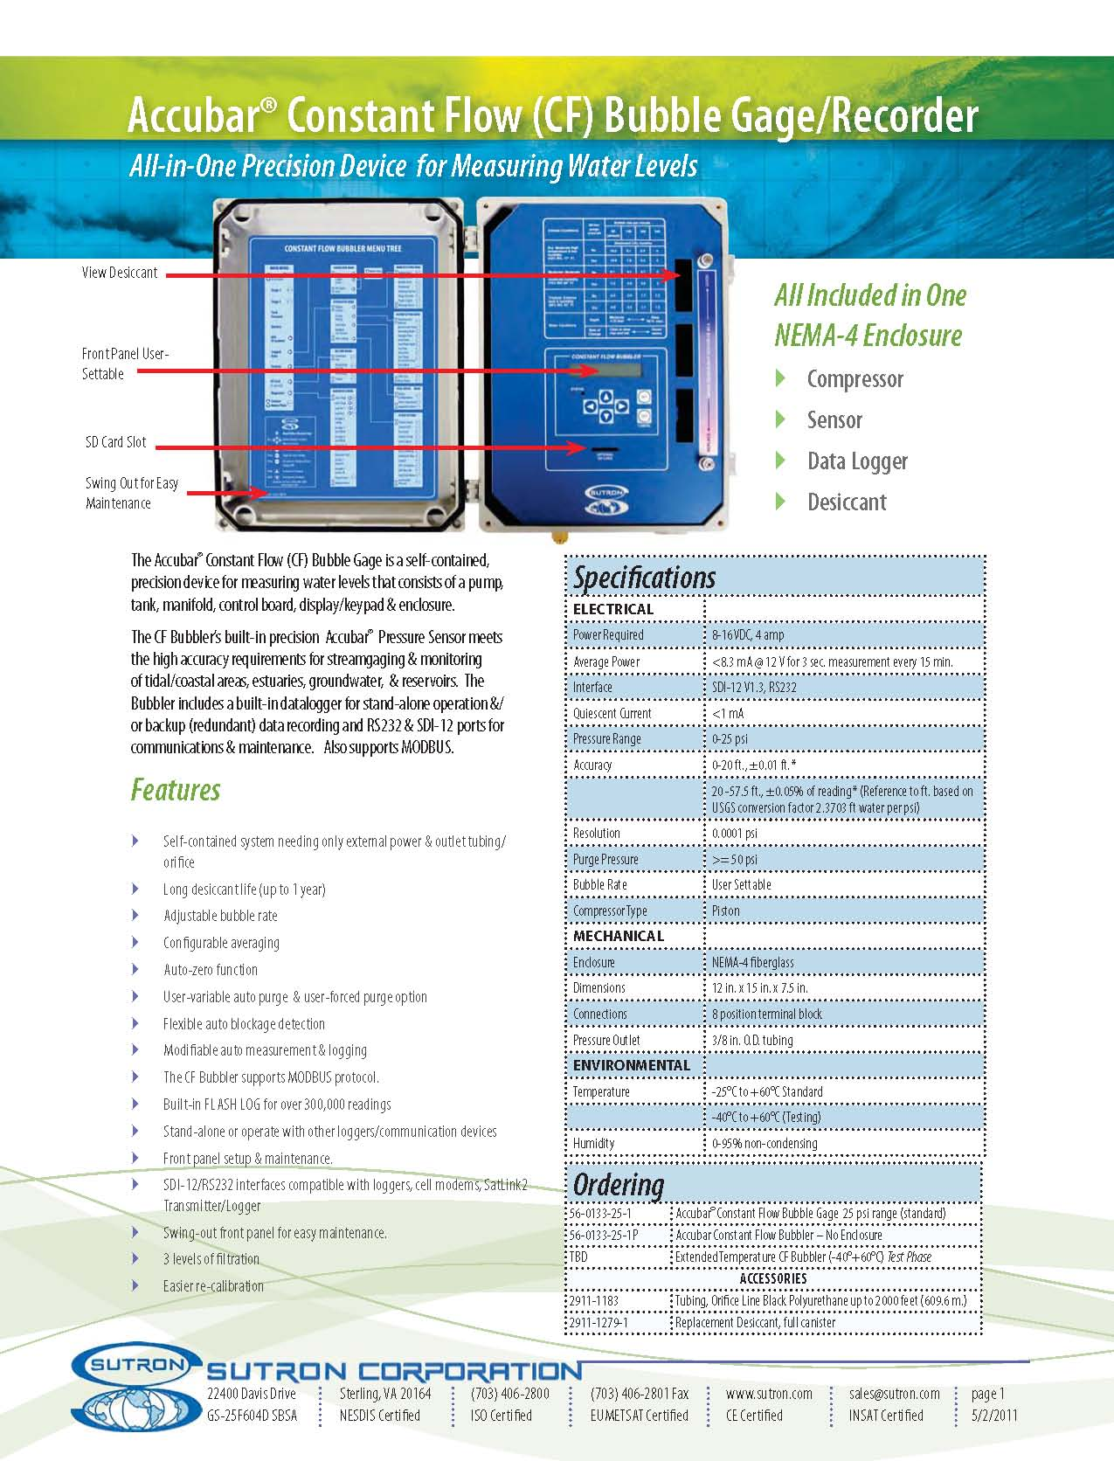
Does Not Meet Specification
X
Tender Specification
Equipment Specification

Slide 6
Steps to be followed
NPMU invites bids from Manufacturers / authorized representatives of the Manufacturer
Any bidder who meet eligibility and qualification criteria
The specifications for all equipment given
Bidder offers his Make and Model of Equipment
NPMU evaluate the equipment against specification and shortlist successful equipment
Manufacturing capacity, product cycle of equipment also analyzed
No financial price / assessment involved

Slide 7
Equipments
Automatic rain gauges | Multi electrode resistivity imaging system
Rain and snow gauges | Time domain electromagnetic (tem) equipment
Snow depth sensor | Resistivity meter (signal averaging system)
Shaft encoder | Multi-parameter digital geophysical logger (500 m)
Radar | Multi-parameter digital geophysical logger (1000 m)
Ultrasonic sensor | Resistivity meter (indigenous or equivalent)
Bubbler | Snow water equivalent
Pressure transducer | Groundwater level sensor with vent tube
Automatic weather stations | Groundwater level sensor without vent tube
ADCP | Data collection platform (data-logger)
GSM / GPRS modem | VSAT trans-receiver
INSAT radio

Slide 8
Second Stage Bid Document
Instruction to Bidders
Warranty Conditions
Payment Conditions
Schedule of Supply and Bill of Quantities
Technical Specifications
Associated services
………….
Refer to List of Models shortlisted in Framework

Slide 9
Second Stage Document
Who can Bid in second stage?
Any Vendor who is otherwise eligible and qualified
Should the Vendor have already participated in Framework agreement?
Not necessary
Which Equipment Make and model a Vendor can offer?
Only the equipment shortlisted in Framework

Slide 10
Project Execution – By IAs
Implementing agencies would invite Second stage Bid
Specify the Schedule of requirement and Bill of Quantities
Specify Associated Services like installation and Operation / Maintenance
Financial Bid Evaluation
Contract award and Contract Management
Installation evaluation and Payment to Vendor

Slide 11
Update of Equipment List
When the shortlisted equipment list is updated?
Every Three Months
Must meet all criteria as per original Framework agreement
In later stage of project…
CWPRS will evaluate each new equipment in testing lab
Framework agreement is an Open Agreement

